Slide 1

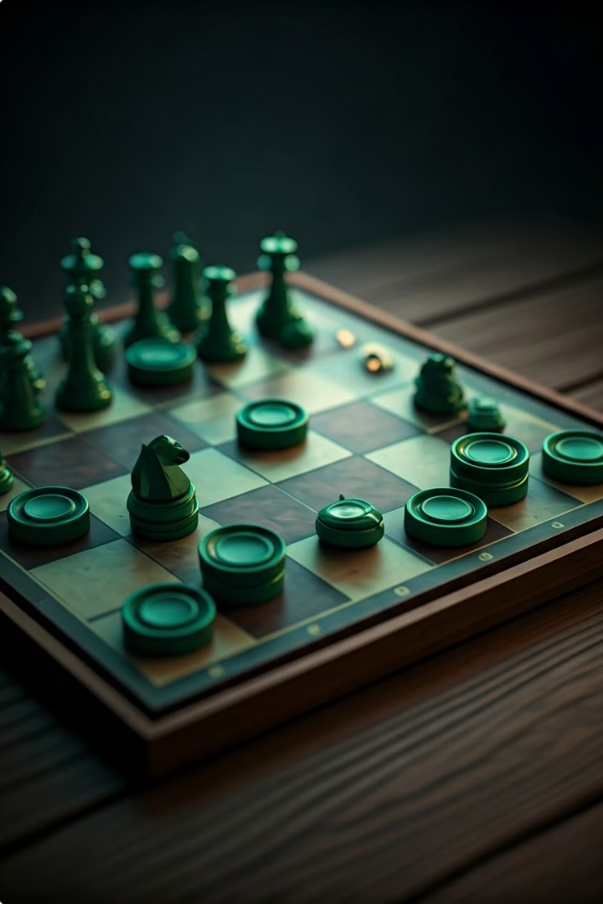
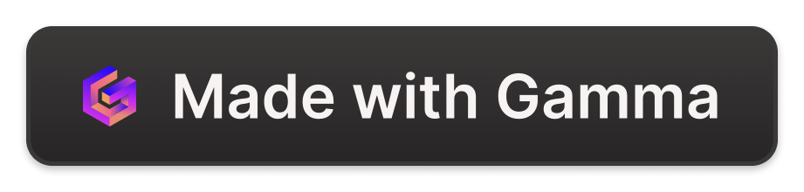
MineCheckers: A Strategic Fusion of Checkers and Minesweeper
Welcome to TheMineCheckers, an innovative game that combines the strategic depth of checkers with the thrilling unpredictability of minesweeper.
Yuval Zindani - 316391424
Matan Dekel - 316592815
Shahar Ben Laiche - 318474277

Slide 2
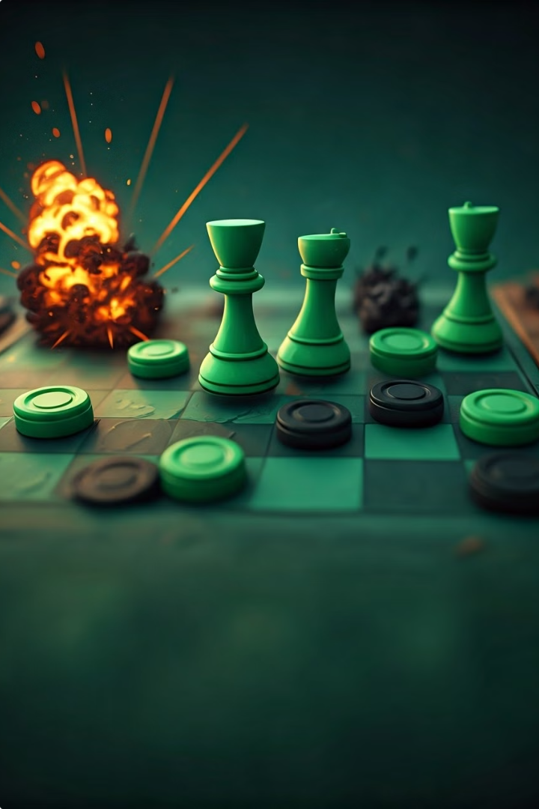
Game Rules and Objectives
1
Board Setup
2
Movement and Capture
The game is played on a 6x5 board with pieces for two players and randomly placed mines. No two mines can be adjacent in the same row, adding an element randomness to the game.
Players take turns moving their pieces diagonally to adjacent empty squares or jumping on opponent pieces to eliminate them,
3
Mine Interaction
4
Winning Conditions
Mines add an extra layer of challenge. Players must navigate around the board carefully to "avoid triggering mines".
Victory is achieved by either reaching the opposite end of the board with a piece or eliminating all opponent pieces.

Slide 3
Implemented Game Features
Mine Reshuffling
AI Opponent
Graphical User Interface
Each player has two opportunities per game to reshuffle the positions of the mines. This feature adds a dynamic element to the game, allowing players to potentially change the board state in their favor or disrupt their opponent's strategy.
The game features an AI opponent powered by the Minimax algorithm with Alpha-Beta Pruning. This provides a challenging and adaptive gameplay experience, as the AI can make strategic decisions based on the current board state and potential future moves.
Built using the Pygame library. The GUI allows for smooth interaction with the game board, piece movement, and mine reshuffling.

Slide 4

Minimax Algorithm Implementation
1
Algorithm Overview
The Minimax algorithm is a decision-making algorithm used in two-player games. It works by simulating all possible moves and their outcomes to determine the optimal move for the AI opponent.
2
Recursive Exploration
The algorithm recursively explores the game tree, alternating between maximizing the AI's score and minimizing the player's score at each level.
3
Evaluation Function
At leaf nodes or a specified depth, an evaluation function assesses the board state, considering factors such as piece count, position, and mine proximity.
4
Best Move Selection
The algorithm propagates scores up the tree, ultimately selecting the move that leads to the best possible outcome for the AI player.

Slide 5
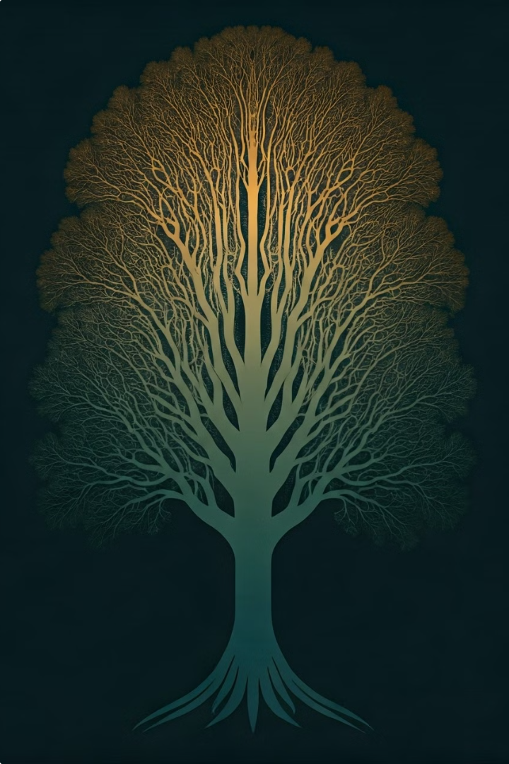




Alpha-Beta Pruning Optimization
Pruning Mechanism
Alpha-Beta Pruning is an optimization technique applied to the Minimax algorithm. It reduces the number of nodes evaluated in the search tree by eliminating branches that cannot possibly influence the final decision.
Alpha and Beta Values
The algorithm maintains two values, alpha and beta, representing the minimum score that the maximizing player is assured of and the maximum score that the minimizing player is assured of, respectively.
Branch Elimination
If the current node's value is worse than the alpha or beta value, depending on the player, the branch is pruned as it cannot affect the final decision.
Improved Efficiency
By pruning irrelevant branches, Alpha-Beta Pruning significantly reduces the number of nodes explored, allowing for deeper searches and faster decision-making by the AI opponent.

Slide 6

Evaluation Function Design
Factor
Weight
Description
Piece Count
High
Number of pieces remaining for each player
Board Position
Medium
Control of strategic positions on the board
Advancement
Medium
Progress of pieces towards the opposite end of the board

Slide 7
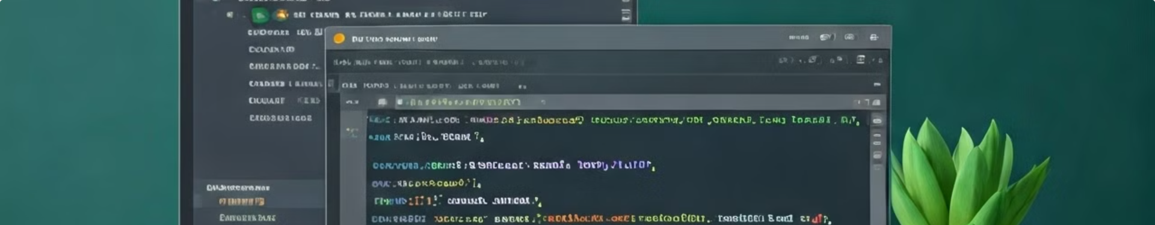



Python and Pygame Implementation
Python Language
Pygame Library
Algorithm Integration
Python was chosen for its simplicity, readability, and extensive library support.
Pygame provided a robust framework for handling graphics, user input, and game loop management.
Python's flexibility allowed for seamless integration of complex algorithms like Minimax and Alpha-Beta Pruning, enabling efficient AI opponent decision-making.

Slide 8

Development Challenges and Solutions
Game Logic Complexity
AI Opponent Optimization
Mine placement and piece movement posed a significant challenge. This was addressed through careful planning, modular code design, and extensive testing to ensure all edge cases were properly handled.
The AI opponent required fine-tuning of the Minimax algorithm and Alpha-Beta Pruning. Our algorithm took into account cases where the AI player's piece was threaten to be "eaten" by the user's piece, therefore, ruling out this move (depending on the situation).
User Interface Design
Designing an intuitive and responsive UI with Pygame presented challenges in terms of event handling and visual feedback.

Slide 9
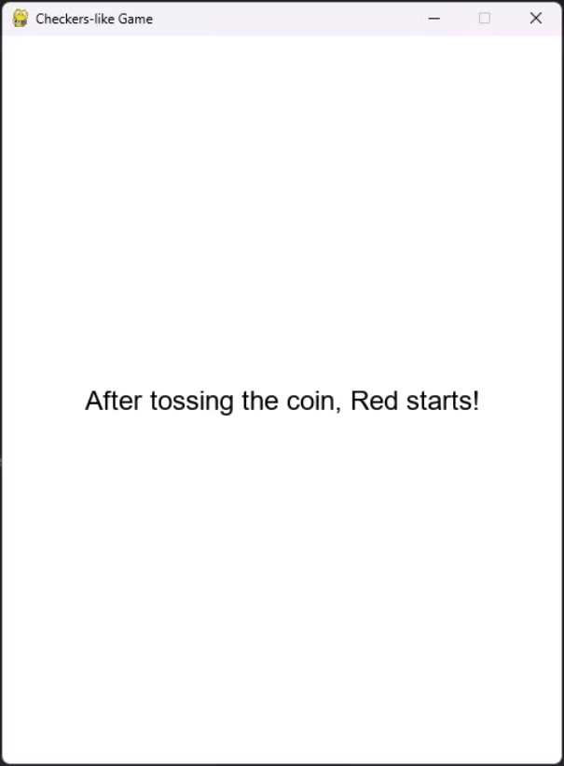

Screen shots
Opening
We can see here that we toss a coin to choose who will open first

Slide 10
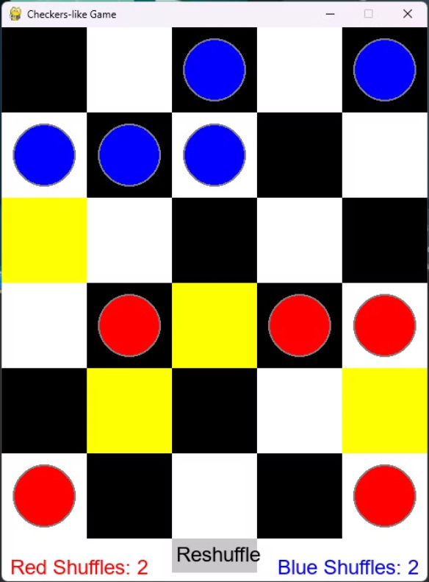
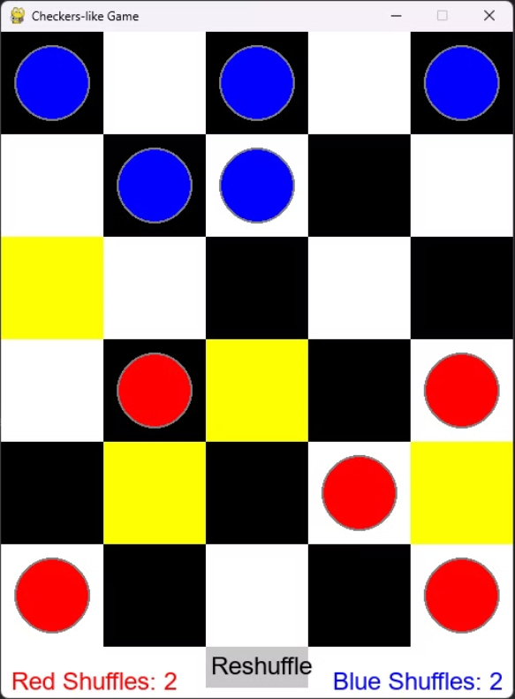
Screen shots
Move - Protection
We can see here that the AI react accordingly to protect its pieces.

Slide 11
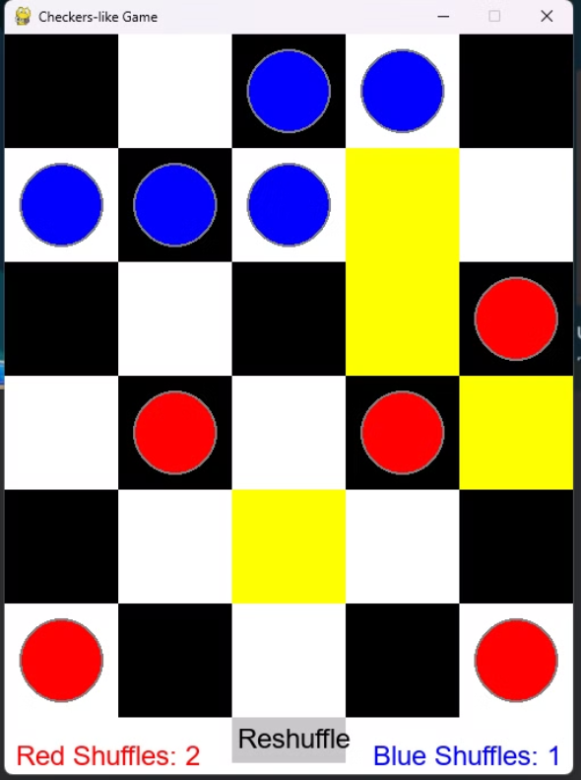
Screen shots
Move - Shuffle
We can see here that the AI felt threatened by the player getting close to the win.

Slide 12
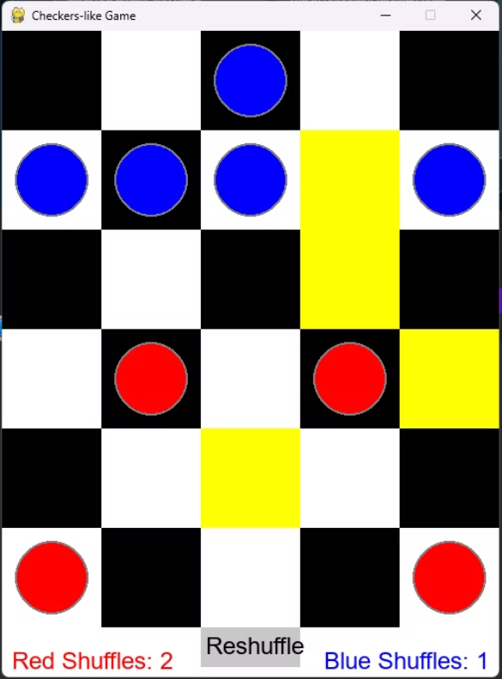
Screen shots
Move - Eating
We can see here that the AI felt saw that the player is about to win and ate the opponent piece.

Slide 13
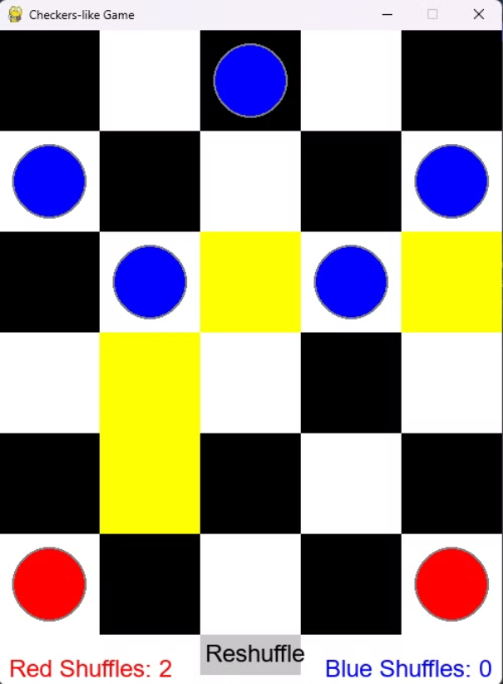

Screen shots
Move - Algorithm
We can see here that the AI moves and his best interest to attack the opponent both by reaching the end and "eating" the pieces. also you can see how protective he is and always have a backup piece in case one is lost.

